Slide 1
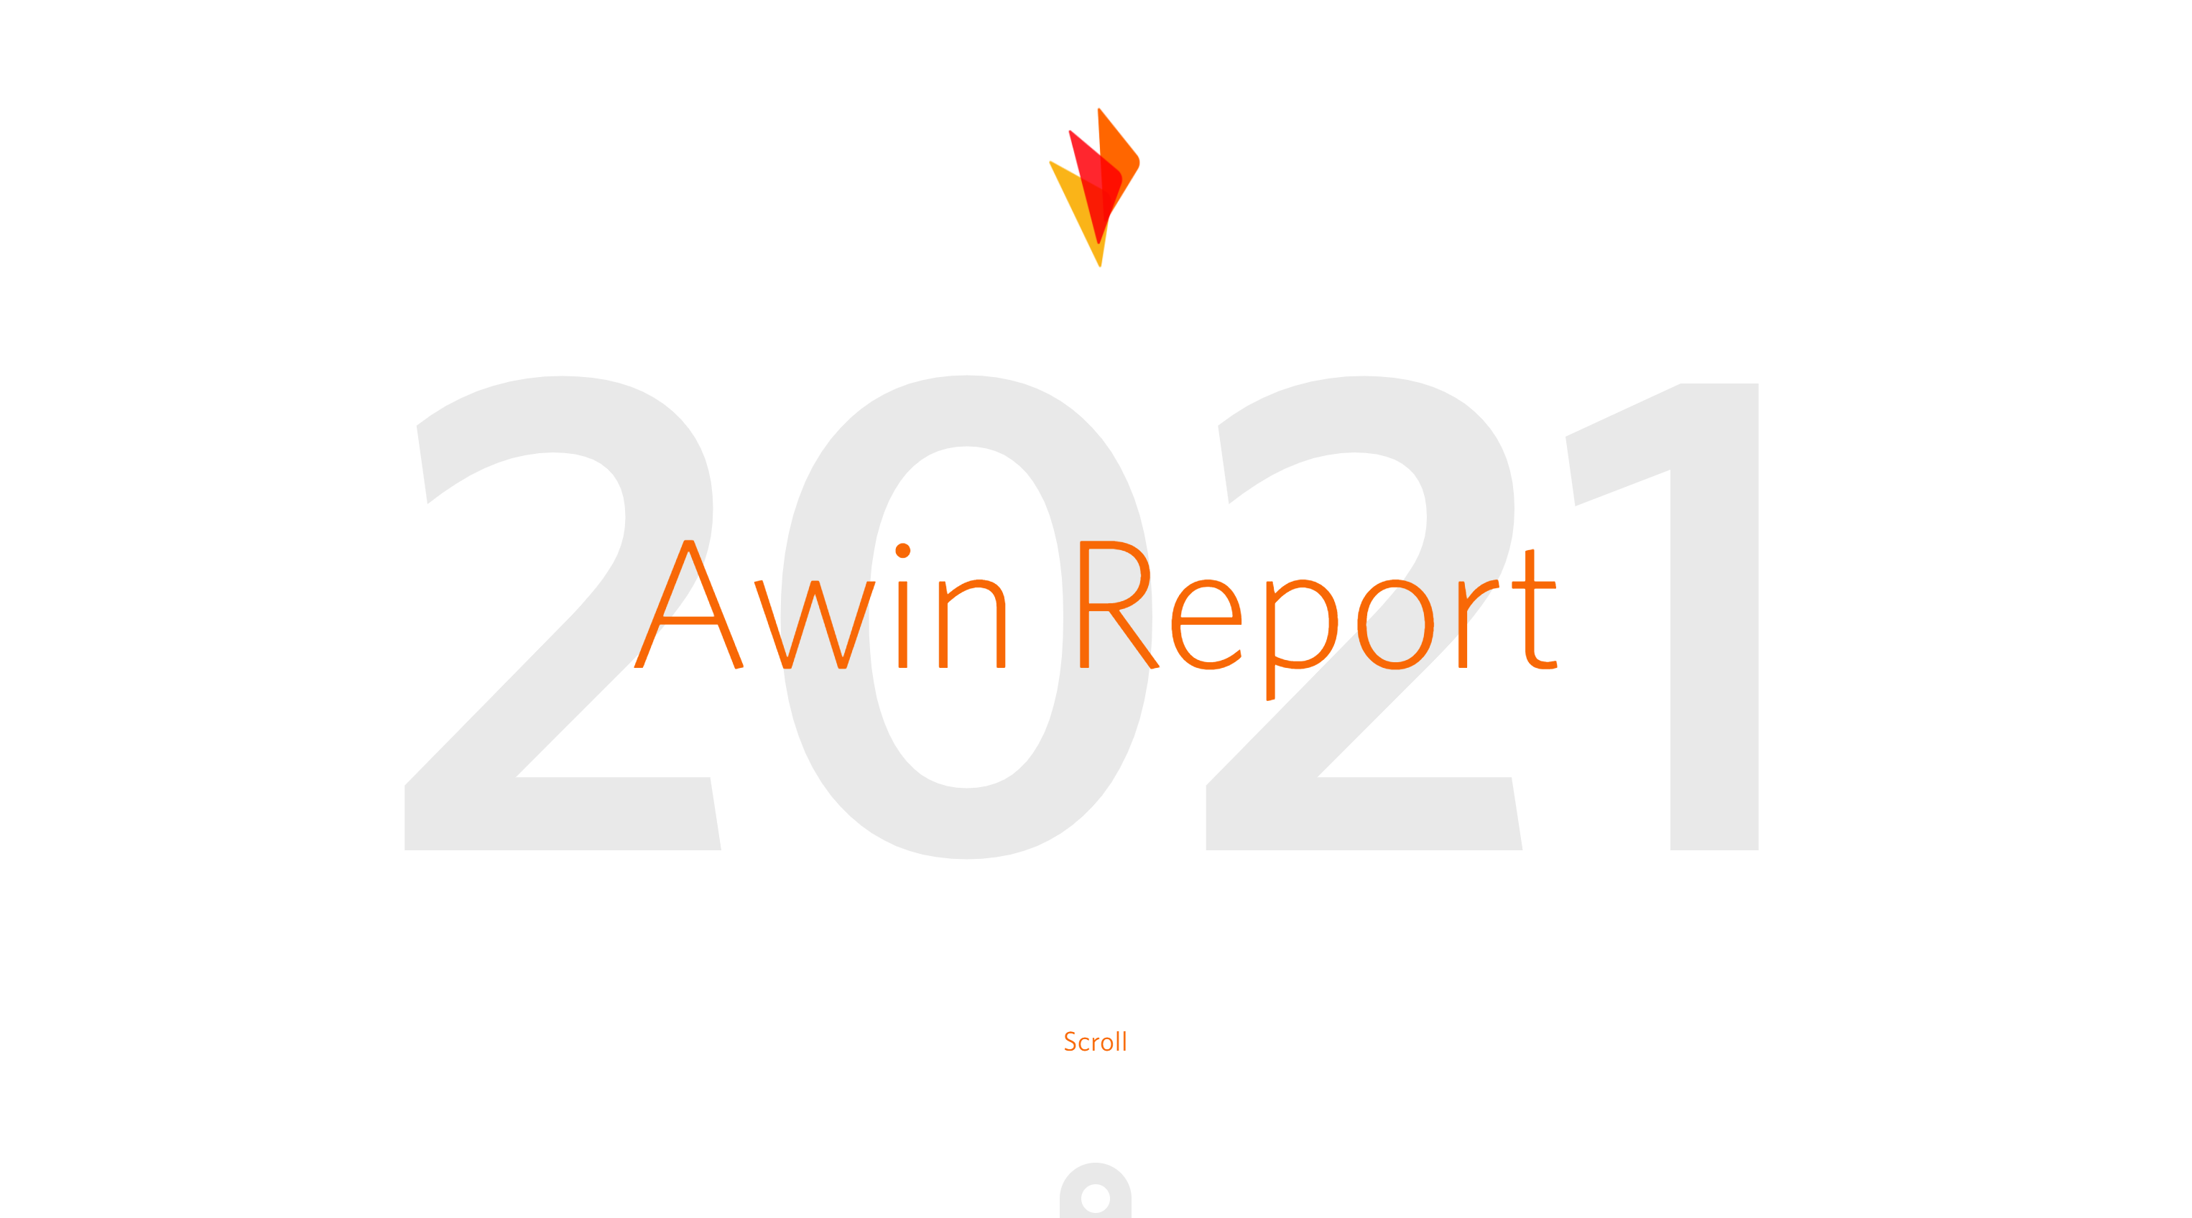
Using content to drive revenue during COVID-19
Amidst coronavirus, LA Apparel launched its inaugural affiliate program on the ShareASale platform alongside full-service digital marketing agency DMiPartners.
LA Apparel leveraged mass media to produce coverage for its new mask line - tapping into a cost-effective, yet powerful, method of promotion.
After just one month, the brand realized great success and secured ample coverage across high-profile content publications.
Los Angeles Apparel is a basics apparel manufacturer and online retailer, passionate about bringing back comfort lines made in the US.
April 2020 saw the brand launch its inaugural affiliate program on the ShareASale platform alongside full-service digital marketing agency DMi Partners. It can take months for a brand to properly launch and integrate a new sales channel. However, COVID-19 caused a major shift in LA Apparel’s core business and the brand began manufacturing cloth face masks.
Affiliate was deemed a perfect match for promoting the new line, making the rapid implementation of its program both a requirement and an obstacle. ShareASale’s all-hands-on-deck mentality helped LA Apparel become revenue active within 24 hours. Following the quick and seamless integration on ShareASale, LA Apparel and DMi Partners implemented a content-based strategy to accelerate the new program.
Ultimately, the speed at which DMi and ShareASale were able to bring LA Apparel’s affiliate program from inception to execution meant publishers' product roundups, a key element of LA Apparel's success, only included a handful of other brands vying for consumer attention. And following an effective activation strategy, the brand secured coverage across 35 high-profile mass media publications including Business Insider, Mashable, Marie Claire, NY Post, Rolling Stone and Women’s Health, among others.
In just one month - thanks to the tools, technology and quality of partners available on ShareASale - the LA Apparel affiliate program saw marked results (Fig. 1).
12.7%
conversion rate
+$1m
revenue
40%
Learn more in the Awin Report
new customers making second purchase
Figure 1

